Slide 1
Today’s Topic
More about function
Slides for CS 31 discussion session
TA: Hsiao-Yun (Katie) Tseng tsenghy@g.ucla.edu
Credit to former TA Bo-Jhang Ho (bojhang@cs.ucla.edu), CS31 Discussion 1E, Spring 17’
Credit to former TA Chelsea Ju (chelsea.ju@cs.ucla.edu)

Slide 2
When we talk about function…
How function are executed in a program
Consumer-Provider relation

Slide 3
An example of a function
int square(int a) { return a * a; } int main() { int a = 3; int b = 6; cout << square(a + b) << endl; return 0; }
Are two variable a’s the same?

Slide 4
An example of a function
int square(int a) { return a * a; } int main() { int a = 3; int b = 6; cout << square(a + b) << endl; return 0; }
Different functions have their own variable sets
Try it on VC++ / Xcode

Slide 5
What is your role?
User
Provider
How to use the function?
What’s the goal of the function?
How do you expect users to use this function?
How do you implement it?

Slide 6
Math example
User
10
1 + 2.7
cout <<

Slide 7
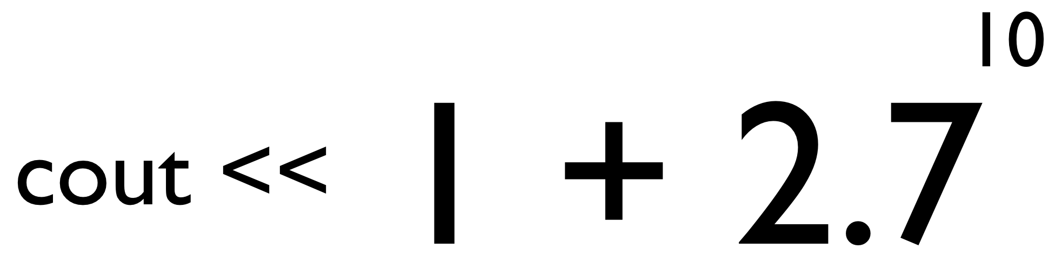
Math example
User
#include <iostream> using namespace std; int main() { cout << ???????????????????? << endl; return 0; }

Slide 8
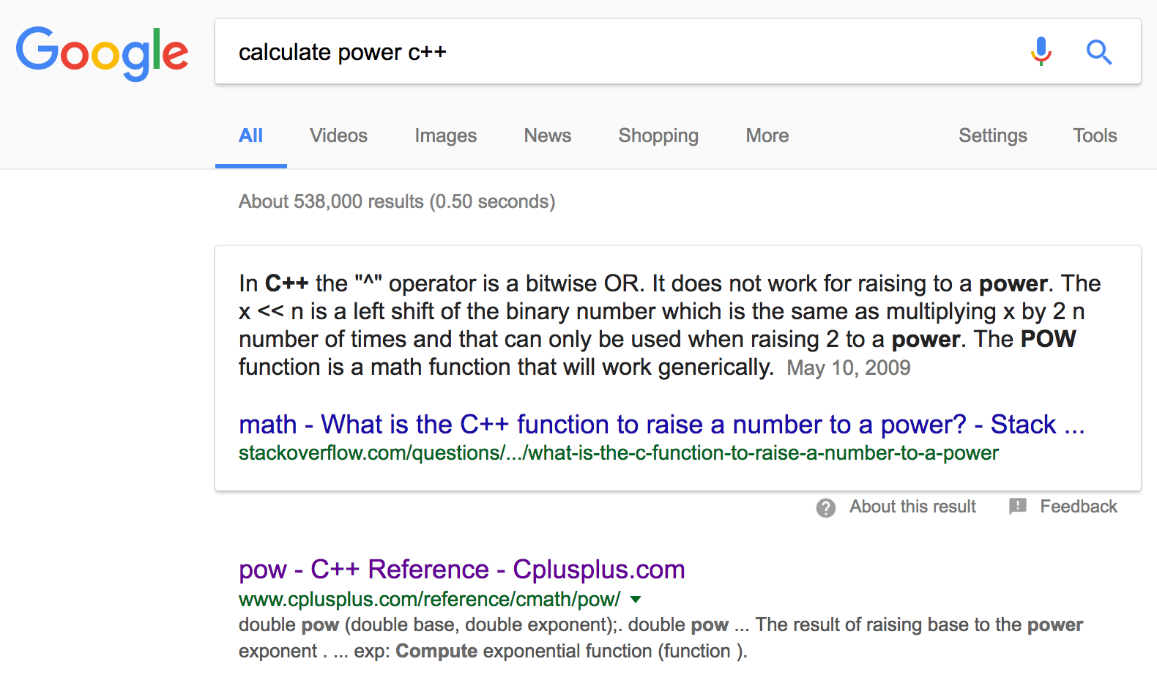
Math example
User
Step 1: Use your own words to ask Google

Slide 9
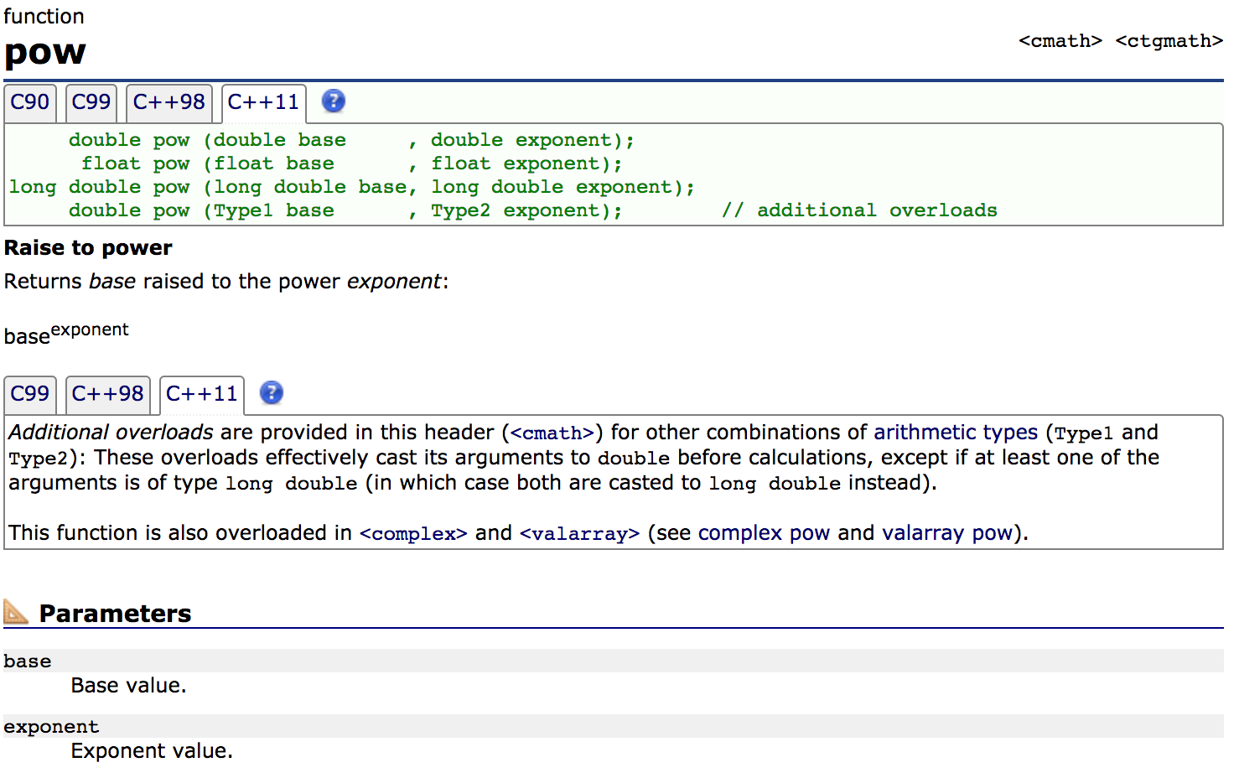
Math example
User
Step 1: Use your own words to ask Google
Step 2: Read the parameter description carefully

Slide 10
Math example
User
#include <iostream> #include <cmath> using namespace std; int main() { cout << (1 + pow(2.7, 10.0)) << endl; return 0; }

Slide 11
Dice throw example
User
cout <<

Slide 12
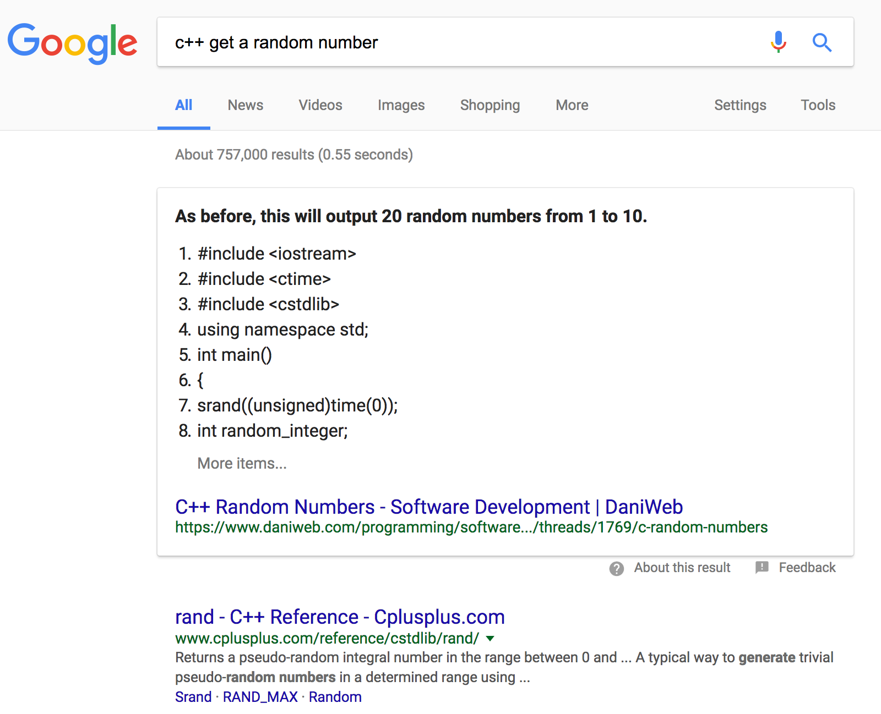
Dice throw example
User
Step 1: Use your own words to ask Google

Slide 13
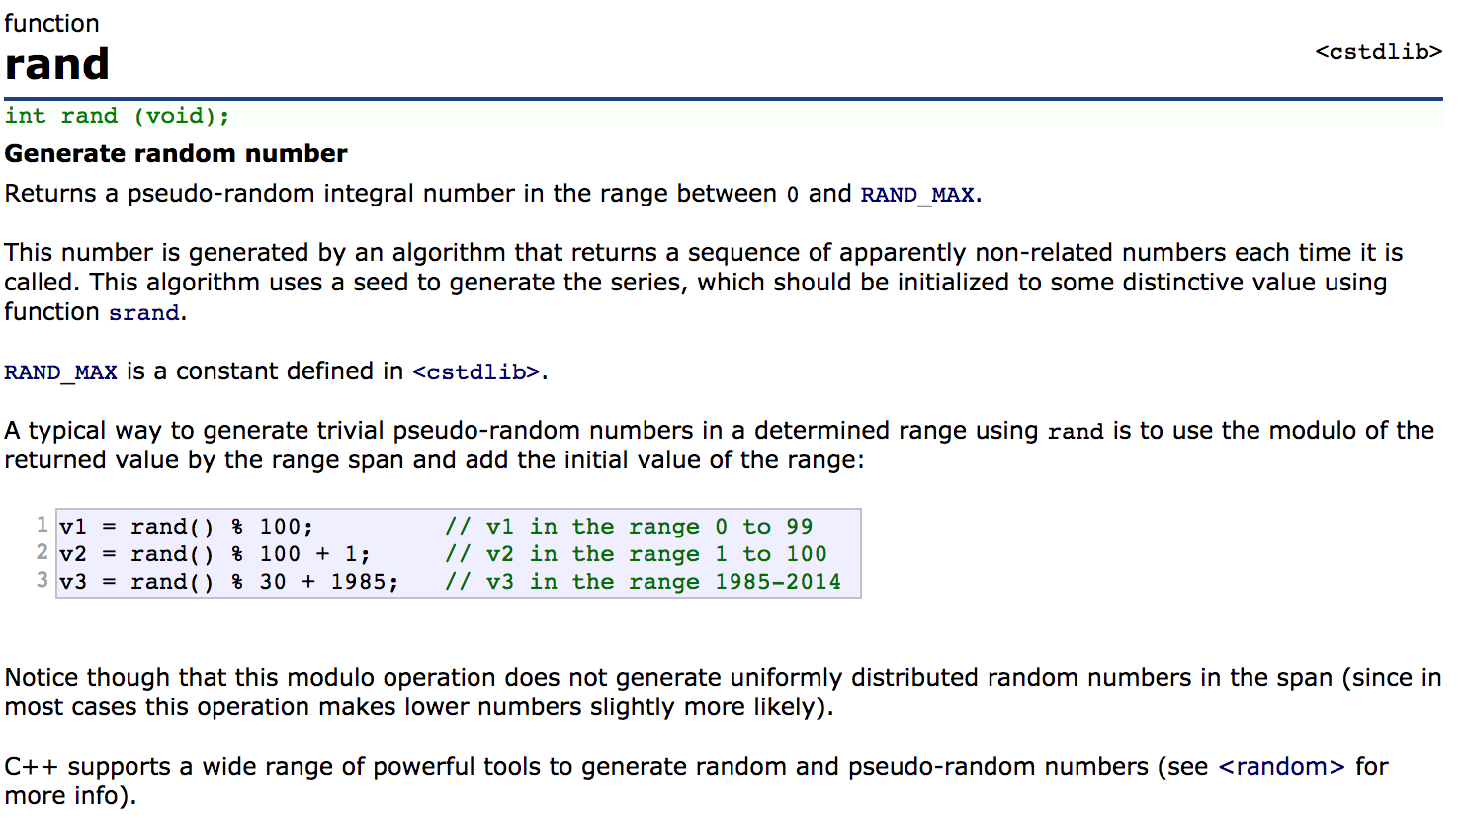
Dice throw example
User
Step 1: Use your own words to ask Google
Step 2: Read the parameter description carefully

Slide 14
Math example
User
#include <iostream> #include <cstdlib> using namespace std; int main() { cout << (rand() % 6 + 1) << endl; return 0; }

Slide 15
Math example
User
#include <iostream> #include <cstdlib> using namespace std; int main() { cout << (rand() % 6 + 1) << endl; return 0; }
Question: why it always give the same value?

Slide 16
Questions you have to ask yourself when developing a function
Provider
What’s the goal of the function?
How do you expect users to use this function?
What information have to pass to your function?
What message are you going to pass back?
How do you implement it?

Slide 17
1. What’s the goal of the function
Provider

Slide 18
2. How people are going to use this function
Provider
A: Hey, I will give you a base and an exponent
B: Sure, I will give you the result

Slide 19
2. How people are going to use this function
Provider

Slide 20
2. How people are going to use this function
Provider
Please pass a coordinate (r, c) to me, remember to mention whether it’s a horizontal line or a vertical line, also give me the length as well as the character. Let me know the mode: I can support both foreground and background.
If I can successfully draw a line based on the parameters you gave me, I tell you true, otherwise I reply false.

Slide 21
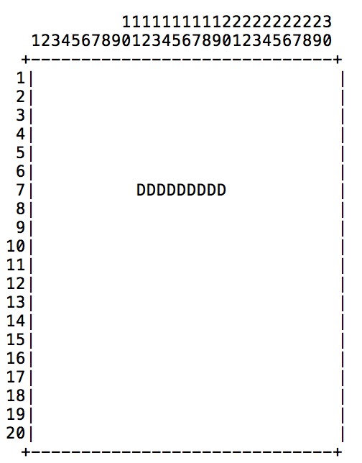
2. How people are going to use this function
Provider
true
distance
dir
plotChar
Start at (r, c)
false

Slide 22
3. How to implement
Provider
Modular design!

Slide 23
3. How to implement
Provider
Modular design!

Slide 24
3. How to implement
Provider
Modular design!

Slide 25
Determine function call graph
void printSpaceStarLine(int numSpaces, int numStars); void printLayer(int startNumSpaces, int startNumStars) { printSpaceStarLine(startNumSpaces, startNumStars); printSpaceStarLine(startNumSpaces - 1, startNumStars + 2); printSpaceStarLine(startNumSpaces - 2, startNumStars + 4); } int main() { printLayer(5, 1); // * // *** // ***** printLayer(4, 3); // *** // ***** // ******* printLayer(3, 5); // ***** // ******* // ********* printLayer(2, 7); // ******* // ********* //*********** printSpaceStarLine(4, 3); // *** printSpaceStarLine(4, 3); // *** return 0; }

Slide 26
Determine function call graph
void printSpaceStarLine(int numSpaces, int numStars); void printLayer(int startNumSpaces, int startNumStars) { printSpaceStarLine(startNumSpaces, startNumStars); printSpaceStarLine(startNumSpaces - 1, startNumStars + 2); printSpaceStarLine(startNumSpaces - 2, startNumStars + 4); } int main() { printLayer(5, 1); printLayer(4, 3); printLayer(3, 5); printLayer(2, 7); printSpaceStarLine(4, 3); printSpaceStarLine(4, 3); return 0; }
main()
paintLayer()
paintSpaceStarLine()
Call direction

Slide 27
Determine function call graph
int factorial(int n) { int prod = 1; for (int i = 2; i <= n; i++) prod *= i; return prod; } int main() { for (int k = 1; k <= 6; k++) { cout << "The factorial of " << k << " is " << factorial(k) << endl; } }
void printFactorial(int n) { int prod = 1; for (int i = 2; i <= n; i++) prod *= i; for (int k = 1; k <= 6; k++) { cout << "The factorial of " << k << " is " << factorial(k) << endl; } } int main() { for (int k = 1; k <= 6; k++) printFactorial(k); }
Function fun question 4
Function fun question 5
main()
factorial()
main()
printFactorial()
Call direction

Slide 28
Determine function call graph
int factorial(int n) { int prod = 1; for (int i = 2; i <= n; i++) prod *= i; return prod; } void printFactorial(int n) { for (int k = 1; k <= n; k++) { cout << "The factorial of " << k << " is " << factorial(k) << endl; } } int main() { for (int k = 1; k <= 6; k++) printFactorial(k); }
main()
printFactorial()
factorial()

Slide 29
3. How to implement
Provider
Always pay attention to what are available to you!

